Slide 1
Sejehtera
Contact tracing system
GROUP 1 BY :
Tan Jenny
Cheng Ling Ern
Cheng Cai Yuan
Tan Yan Pin
Vincent Choo

Slide 2
- ABOUT US -
02
01
04
03
Everyone who is visiting the venue must supply their information
A system to ensure the safety of the college
Contact data that will be collected by the system will only be accessed by the admin
This system completely preserves students or staff privacy and also their personal information .

Slide 3
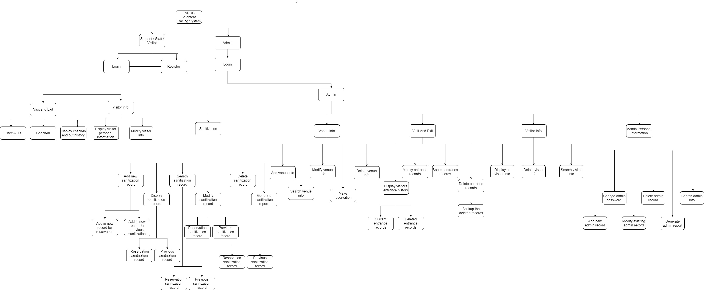
STRUCTURE CHART

Slide 4
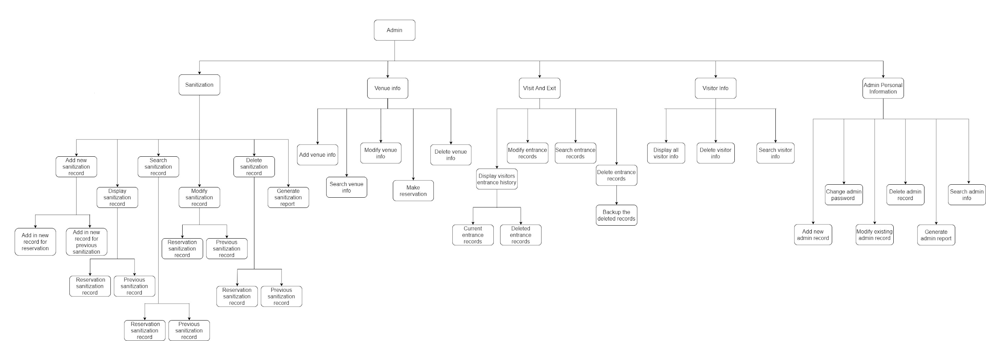
ADMIN SITE

Slide 5
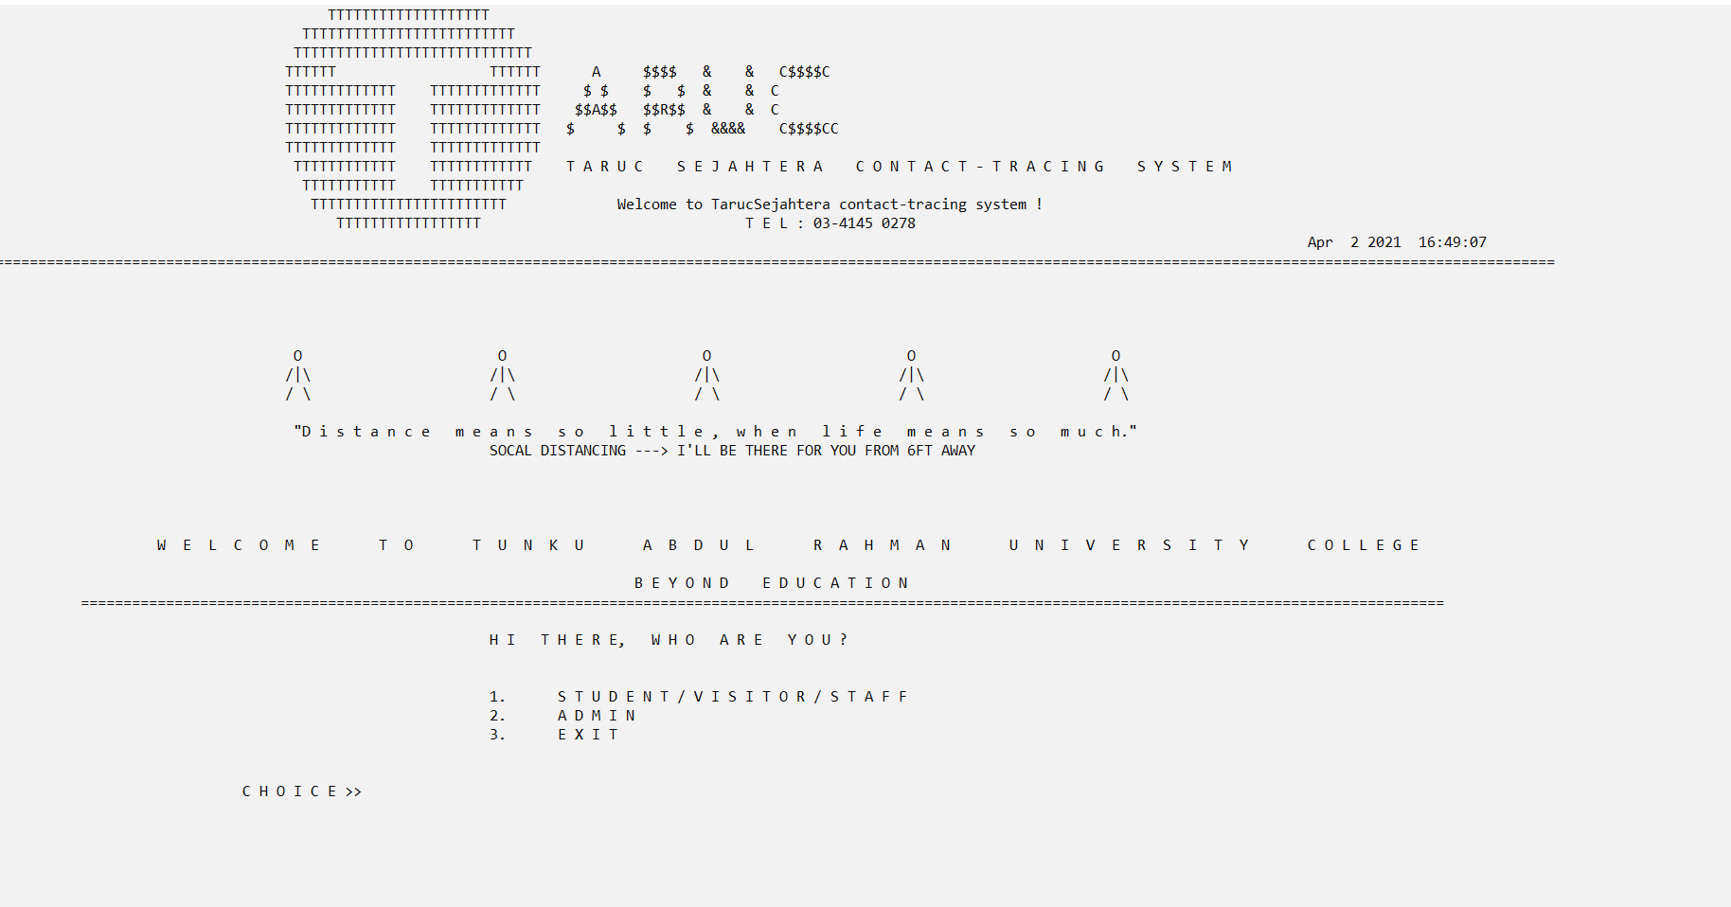
INTRODUCTION OF HOME SCREEN
The design is using the people to stand with each other on a specific distance in order to remind each other of social distancing to safeguard everyone's safety.

Slide 6
01
VISITOR
BY : VINCENT CHOO

Slide 7
ABOUT VISITOR INFORMATION MODULE
It is to assist in monitoring COVID-19 pandemic in country that used by students or staff in Tarc college by empowering students or staff to assess current risk against covid-19.
The visitor information module stores all data and information of existing visitor accounts in the system.
It also allows new visitor to register for a new account into order to record the entry and exit on a venue.

Slide 8
TYPE OF STRUCTURE
Tagged structure
Tagged structure
Typedef structure

Slide 9
Tagged structure
Tagged structure
struct Date {
int day, month, year;
};

Slide 10
2. Typedef Structure
Tagged structure
typedef struct {
char visitorUserId[10];
char visitorIcNo[13];
char visitorPassportNo[10];
char visitorName[150];
char visitorGender;
struct Date visitorBd;
char visitorEmail[50];
char visitorContactNo[13];
char visitorAddress[100];
int visitorAccStatus;
}VisitorInfo;
Nested structure

Slide 11
Tagged structure
typedef struct {
int noCharacter;
int noAlphabet;
int noDigit;
int noSpecialCharacter;
int noSpace;
int noSpecialCharacterWithoutSpace;
}Validation;

Slide 12
Text file
Tagged structure
Stores the existing user account details such as User ID, IC No, passport number, full name, gender, birth date, email address, contact number, home address and account status.
Stores the password of existing user account.

Slide 13
Type of Functions
Tagged structure
Function Returns No Result
Function Returns Single Result
Function With Parameter
Function Returns Multiple Results

Slide 14
Function That Returns No Result
void displayAdminRecordFunction() {
h2HorizontalRule();
printf(" DISPLAY ADMIN INFORMATION RECORDS \n");
h2HorizontalRule();
printf("\n\n");
//variables
VisitorInfo displayR[1000];
int totalNumberOfAccount = 0;
//OPEN TEXT FILE AND FOR REAING (strcmp current userID with existing userID)
FILE* displayRecordFptr;
displayRecordFptr = fopen("visitor-info-database2.txt", "r");
while (displayRecordFptr == NULL) {
printf("ERROR. File cannot be open due to not found.");
exit(-1);}
int a = 0;
int num = 0;

Slide 15
while (fscanf(displayRecordFptr, "%[^\|]|%[^\|]|%[^\|]|%[^\|]|%c|%d/%d/%d|%[^\|]|%[^\|]|%[^\|]|%d|\n", &displayR[a].visitorUserId, &displayR[a].visitorIcNo, &displayR[a].visitorPassportNo, &displayR[a].visitorName, &displayR[a].visitorGender, &displayR[a].visitorBd.day, &displayR[a].visitorBd.month, &displayR[a].visitorBd.year, &displayR[a].visitorEmail, &displayR[a].visitorContactNo, &displayR[a].visitorAddress, &displayR[a].visitorAccStatus) != EOF)
{
a++;
}
fclose(displayRecordFptr);
totalNumberOfAccount = a;
printf("==================================================================================================================================================================\n");
printf("|User ID| User IC | Pp.No| Full Name |Sex| B.Date | Email | Contact No | Home Address |S|\n");
printf("|=======+============+======+=======================+===+========+============================+======+========================================================+=|\n");
//loop to print all record
for (int i = 0; i < a; i++) {
if (displayR[i].visitorUserId[0] == 'A') {
printf("|%7s|%12s|%6s|%23s| %c |%04d/%02d/%02d|%20s|%12s|%57s|%d|\n", displayR[i].visitorUserId, displayR[i].visitorIcNo, displayR[i].visitorPassportNo, displayR[i].visitorName, displayR[i].visitorGender, displayR[i].visitorBd.year, displayR[i].visitorBd.month, displayR[i].visitorBd.day, displayR[i].visitorEmail, displayR[i].visitorContactNo, displayR[i].visitorAddress, displayR[i].visitorAccStatus);
//printf("|=======+============+======+=======================+===+========+============================+======+========================================================+=|\n");
}
}

Slide 16
printf("\n\n\n");
system("\n\npause");
char endDisplayRecord;
do { printf("Would you like to return to the Profile Menu? (Y/N) >");
rewind(stdin);
scanf("%c", &endDisplayRecord);
endDisplayRecord = toupper(endDisplayRecord);
switch (endDisplayRecord) {
case 'Y':
printf("\nYou will now be directed to the Profile Menu.\n");
system("pause");
system("cls");
return 0;
break;
case 'N':
printf("\n");
system("pause");
endDisplayRecord = 'O';
break;
default: printf("ERROR. Please choose the available options.\n\n\n");
break;
}
} while (endDisplayRecord != 'Y' && endDisplayRecord != 'N');
}

Slide 17
Function that Returns Single Result
int isChar(char emailChar)
{
if ((emailChar >= 'a' && emailChar <= 'z') || (emailChar >= 'A' && emailChar <= 'Z')) {
return 1;
}
else return 0;
}

Slide 18
Function that Returns Multiple Results
Validation universalCharacterCheck(char inputCharacter[]) {
Validation outputCharacter;
int qCharacter = 0;
int qAlphabet = 0, qDigit = 0, qSpecialCharacter = 0, qSpace = 0, qSpecialCharacterWithoutSpace = 0;
/* Checks each character of string*/
while (inputCharacter[qCharacter] != '\0')
{
if ((inputCharacter[qCharacter] >= 'a' && inputCharacter[qCharacter] <= 'z') ||
(inputCharacter[qCharacter] >= 'A' && inputCharacter[qCharacter] <= 'Z')) {
qAlphabet++;
}
else if (inputCharacter[qCharacter] >= '0' && inputCharacter[qCharacter] <= '9') {
qDigit++;
}
else if (inputCharacter[qCharacter] == ' ') {
qSpace++;
qSpecialCharacter++;
}
Else {
qSpecialCharacter++;
qSpecialCharacterWithoutSpace++;
}
qCharacter++;
}

Slide 19
outputCharacter.noCharacter = qCharacter;
outputCharacter.noAlphabet = qAlphabet;
outputCharacter.noDigit = qDigit;
outputCharacter.noSpecialCharacter = qSpecialCharacter;
outputCharacter.noSpace = qSpace;
outputCharacter.noSpecialCharacterWithoutSpace = qSpecialCharacterWithoutSpace;
return outputCharacter;
}

Slide 20
Function with Input/Output Parameter
// Function to check email id is
// valid or not
int is_valid(char email[50])
{
// Check the first character is an alphabet or not
if (isChar(email[0] == 0)) {
// If it's not an alphabet email id is not valid
return 0;
}
// Variable to store position of At and Dot
int At = -1, Dot = -1;
// Traverse over the email id string to find position of Dot and At
for (int i = 0; i < strlen(email); i++) {
// If the character is '@'
if (email[i] == '@') {
At = i;
}
// If character is '.'
else if (email[i] == '.') {
Dot = i;
}
}

Slide 21
// If either @ or '.' is not present
if (At == -1 || Dot == -1) {
return 0;
}
// If Dot is present before At
else if (At > Dot) {
return 0;
}
// If Dot is present at the end
else if (Dot >= (strlen(email) - 1)) {
return 0;
}
// If everything is validated, return 1
else return 1;
}

Slide 22
Extra Features
System unto assign the User ID to new registered account based on the nationality and the number of account.
//CREATING USER ID
if (createUserId == 1) {
VisitorInfo user[1000];
// opening text file and checking if file can open or not
registerFptr = fopen("visitor-info-database2.txt", "r");
while (registerFptr == NULL) {
printf("ERROR. File cannot be open due to not found.");
exit(-1);
}
int i = 0;
int totalNumberOfAccounts = 0, fourDigits = 0;
char firstChar[10] = " ";
firstChar[0] = 'V';
// scanning existing accounts
while (fscanf(registerFptr, "%[^\|]|%[^\|]|%[^\|]|%[^\|]|%c|%d/%d/%d|%[^\|]|%[^\|]|%[^\|]|%d|\n", &user[i].visitorUserId, &user[i].visitorIcNo, &user[i].visitorPassportNo, &user[i].visitorName, &user[i].visitorGender, &user[i].visitorBd.day, &user[i].visitorBd.month, &user[i].visitorBd.year, &user[i].visitorEmail, &user[i].visitorContactNo, &user[i].visitorAddress, &user[i].visitorAccStatus) != EOF)
{
i++;
}

Slide 23
totalNumberOfAccounts = i;
fourDigits = i;
fclose(registerFptr);
//ASSIGNING USER ID
//decide the role in User ID (V= regular, F= foreigner, A=admin)
if (citizenshipStatus == 0) {
firstChar[0] = 'F';
}
char tempAccNo[10];
//increase the previous AccNo by 1
fourDigits++;
//COMBINING both firstChar and AccountNo
//converting accountNo to string
sprintf(tempAccNo, "%03d", fourDigits);
//concatenate firstChar and AccNo
strcat(firstChar, tempAccNo);
strcpy(newAcc.visitorUserId, firstChar);
//FPRINF INTO 2 FILES (visitor-info-database.txt & password.txt)

Slide 24
FILE* pwFptr;
registerFptr = fopen("visitor-info-database2.txt", "a");
pwFptr = fopen("password.txt", "a");
if (registerFptr == NULL) {
printf("ERROR. File cannot be open due to not found.");
exit(-1);
}
while (pwFptr == NULL) {
printf("ERROR. File cannot be open due to not found.");
exit(-1);
}
//fprint into text file (visitor-info-database.txt)
fprintf(registerFptr, "\n%s|%s|%s|%s|%c|%02d/%02d/%04d|%s|%s|%s|1|", newAcc.visitorUserId, newAcc.visitorIcNo, newAcc.visitorPassportNo, newAcc.visitorName, newAcc.visitorGender, newAcc.visitorBd.day, newAcc.visitorBd.month, newAcc.visitorBd.year, newAcc.visitorEmail, newAcc.visitorContactNo, newAcc.visitorAddress);
//fprint into text file (password.txt)
fprintf(pwFptr, "\n%s", newPassword);
fclose(registerFptr);
fclose(pwFptr);
printf("\nYour information successfully saved. directed to main menu\n");
printf("\nYour PERSONAL USER ID is : %s \n", newAcc.visitorUserId);
system("pause");
system("cls"); loginHeader(4);
visitorMenu();
return 0;
}

Slide 25
Extra Features
while (fscanf(fptrR, "%[^\t]\t%[^\t]\t%[^\t]\t%d\t%[^\-]-%[^\t]\t%d-%d\t%[^\t]\t%d/%d/%d %d\n", &v[count].venueID, &v[count].venueCat, &v[count].venueName, &v[count].maxVis, &v[count].timeDay.day.opStartDay, &v[count].timeDay.day.opEndDay, &v[count].timeDay.opStartTime, &v[count].timeDay.opEndTime, &v[count].status, &v[count].saniTime.saniYear, &v[count].saniTime.saniMonth, &v[count].saniTime.saniDay, &v[count].currentVisitors) != EOF) {
count++;
}

Slide 26
02
VENUE
BY : DAVID TAN YAN PIN

Slide 27
About the venue information module
-this module primarily is to store the venue information data
-only admin can access to the venue information
-allow user to make reservations for any occasions

Slide 28
Structure Type
Tagged struct
Typedef struct
Struct variable

Slide 29
Tagged structure
struct opDay {
char opStartDay[100], opEndDay[100];
};
struct opTime {
int opStartTime, opEndTime;
struct opDay day;
};

Slide 30
Structure variable
struct {
char venueID[5], venueCat[25], venueName[25], status[12];
int maxVis, currentVisitors;
struct opTime timeDay;
Sanitization saniTime;
}v[1000];

Slide 31
Typedef structure
typedef struct {
char venueId[5];
int reserveYear, reserveMonth, reserveDay, reserveStartHr, reserveStartMin, reserveEndHr, reserveEndMin;
char reserveReason[100];
}reserve;
typedef struct {
int saniDay, saniMonth, saniYear;
}Sanitization;

Slide 32
File type
Binary File
Text file

Slide 33
Text file
-store the venue information
-whole module use this text file

Slide 34
Binary file
-store reservation record
-only reservation module used this file

Slide 35
Function type
1.return no value
2.return 1 result
3.function with input/output parameter

Slide 36
Return no value
void displayVenue() {
FILE* fptrR, * binR;
fptrR = fopen("venue.txt", "r");
binR = fopen("reserve.bin", "rb");
int i = 0, recordChoice = 0, validInput = 0, count = 0, confirm = 0;
char intCheck[10],confirmation;
if (fptrR == NULL || binR == 0) {
printf("Error, unable to open the file\n");
exit(-1);
}
…...

Slide 37
Function return 1 result and 1 input parameter
int integerCheck(char input[])
{
int number = 0;
for (int i = 0; i < strlen(input); i++) {
if (isalpha(input[i]) != 0) {
printf("Invalid input\n");
number = 0;
return number;
}
else
number = atoi(input);
}
return number;
}
Validate if the input is digit
Return single value

Slide 38
Function with output parameter
void updateStatus(char* status) {
//declare type definitions structure for date and time
typedef struct {
int start_hour, start_minute, end_hour, end_minute, san_day, san_month, san_year;
}DateTime;
//declare tagged structure for sanitization detail
struct SanitizationDetail {
char venue[50];
DateTime datetime;
};
//declare structure variable for sanitization.txt
struct {
char com_Name[80], contact_Person[50], address[100];
char per_Number[12], com_Number[10], ID[7];
struct SanitizationDetail detail;
}s, sRecord[100];

Slide 39
//declare type definitions for service details
typedef struct {
double service_tax;
int service_rate;
}Service;
//declare tagged structure for payment.dat
struct PaymentDetail {
char pay_ID[7], san_ID[7], pay_method[20], pay_merchant[20], sanitizer_brand[30];
double pay_amount;
Service service;
};
FILE* fptrR, * fptrSR, * binR, * binW;
fptrR = fopen("venue.txt", "r");
fptrSR = fopen("sanitization.txt", "r");
binR = fopen("reserve.bin", "rb");
int h = 0, b = 0, x = 0, found = 0, foundTime = 0, c = 0;
char test[300];

Slide 40
if (fptrR == NULL || fptrSR == NULL) {
printf("Error, unable to open the file1\n");
exit(-1);
}
if (binR == 0) {
printf("Error, unable to open the file2\n");
exit(-1);
}
//get system time
time_t t = time(NULL);
struct tm tm = *localtime(&t);
while (fread(&reserveV[b], sizeof(reserve), 1, binR) != 0) {
b++;
}

Slide 41
while (fscanf(fptrR, "%[^\t]\t%[^\t]\t%[^\t]\t%d\t%[^-]-%[^\t]\t%d-%d\t%s\t%d/%d/%d\t%d\n", &v[h].venueID, &v[h].venueCat, &v[h].venueName, &v[h].maxVis, &v[h].timeDay.day.opStartDay, &v[h].timeDay.day.opEndDay, &v[h].timeDay.opStartTime, &v[h].timeDay.opEndTime, &v[h].status, &v[h].saniTime.saniYear, &v[h].saniTime.saniMonth, &v[h].saniTime.saniDay, &v[h].currentVisitors) != EOF) {
h++;
}
while (fscanf(fptrSR, "%[^\t]\t%d/%d/%d\t%[^\t]\t%d:%d\t%d:%d\t%[^\t]\t%[^\t]\t\t%[^\t]\t%[^\t]\t%[^\n]\n", &sRecord[x].ID, &sRecord[x].detail.datetime.san_day, &sRecord[x].detail.datetime.san_month, &sRecord[x].detail.datetime.san_year, &sRecord[x].detail.venue, &sRecord[x].detail.datetime.start_hour, &sRecord[x].detail.datetime.start_minute, &sRecord[x].detail.datetime.end_hour, &sRecord[x].detail.datetime.end_minute, &sRecord[x].com_Name, &sRecord[x].com_Number, &sRecord[x].contact_Person, &sRecord[x].per_Number, &sRecord[x].address) != EOF) {
x++;
}
Get all the record from binary or text file into structure

Slide 42
for (int i = 0; i < b; i++) {
if (reserveV[i].reserveYear == tm.tm_year + 1900) {
if (tm.tm_mon + 1 == reserveV[i].reserveMonth) {
if (tm.tm_mday == reserveV[i].reserveDay) {
if (tm.tm_hour == reserveV[i].reserveStartHr) {
if (tm.tm_hour * 100 + tm.tm_min == reserveV[i].reserveStartHr * 100 + reserveV[i].reserveStartMin) {
strcpy(&status, "UNAVAILABLE");
}
}
else if (tm.tm_hour == reserveV[i].reserveEndHr) {
if (tm.tm_hour * 100 + tm.tm_min == reserveV[i].reserveEndHr * 100 + reserveV[i].reserveEndMin) {
strcpy(&status, "AVAILABLE");
binW = fopen("reservetmp.bin", "wb");
if (binW == 0) {
printf("Error, unable to open the file2\n");
exit(-1);
}
Check if the record time is match system time

Slide 43
while (fread(&reserveV[0], sizeof(reserve), 1, binR) != NULL) {
if (tm.tm_hour == reserveV[i].reserveEndHr && tm.tm_min == reserveV[i].reserveEndMin)
found = 1;
else
fwrite(&reserveV[i], sizeof(reserve), 1, binW);
fclose(binW);
remove("reserve.bin");
rename("reservetmp.bin", "reserve.bin");
}
}
}
}
}
}
}

Slide 44
for (int i = 0; i < x; i++) {
if (sRecord[i].detail.datetime.san_year == tm.tm_year + 1900) {
if (tm.tm_mon + 1 == sRecord[i].detail.datetime.san_month) {
if (tm.tm_mday == sRecord[i].detail.datetime.san_day) {
if (tm.tm_hour >= sRecord[i].detail.datetime.start_hour) {
if (tm.tm_hour * 100 + tm.tm_min >= sRecord[i].detail.datetime.start_hour * 100 + sRecord[i].detail.datetime.start_minute) {
foundTime = i;
for (int c = 0; c < h; c++) {
if (strcmp(v[c].venueName, sRecord[foundTime].detail.venue) == 0) {
strcpy(&status, "UNAVAILABLE");
}
}
}
}

Slide 45
else if (tm.tm_hour >= sRecord[i].detail.datetime.end_hour) {
if (tm.tm_hour * 100 + tm.tm_min >= sRecord[i].detail.datetime.end_hour * 100 + sRecord[i].detail.datetime.end_minute) {
foundTime = i;
for (int c = 0; c < t; c++);
if (strcmp(v[c].venueName, sRecord[foundTime].detail.venue) == 0)
strcpy(&status, "AVAILABLE");
}
}
}
}
}
}
fclose(fptrR);
fclose(binR);
return 0;
}

Slide 46
Extra feature
Auto assign venue id for user when adding a new venue
while (fscanf(fptrR, "%[^\t]\t%[^\t]\t%[^\t]\t%d\t%[^\-]-%[^\t]\t%d-%d\t%[^\t]\t%d/%d/%d %d\n", &v[count].venueID, &v[count].venueCat, &v[count].venueName, &v[count].maxVis, &v[count].timeDay.day.opStartDay, &v[count].timeDay.day.opEndDay, &v[count].timeDay.opStartTime, &v[count].timeDay.opEndTime, &v[count].status, &v[count].saniTime.saniYear, &v[count].saniTime.saniMonth, &v[count].saniTime.saniDay, &v[count].currentVisitors) != EOF) {
count++;
}
printf("\n\t\t\t\t\t\tEnter T%.3d venue name:", count);
scanf("%[^\n]", &inputName);
rewind(stdin);
fprintf(fptrA, "T%.3d\t%s\t%s\t%d\t%s-%s\t%d-%d\t%s\t%d/%d/%d\t%d\n", count, v[0].venueCat, v[0].venueName, v[0].maxVis, v[0].timeDay.day.opStartDay, v[0].timeDay.day.opEndDay, v[0].timeDay.opStartTime, v[0].timeDay.opEndTime, v[0].status, v[0].saniTime.saniYear, v[0].saniTime.saniMonth, v[0].saniTime.saniDay, v[0].currentVisitors);

Slide 47
03
Administrative
By: Cheng Ling Ern

Slide 48
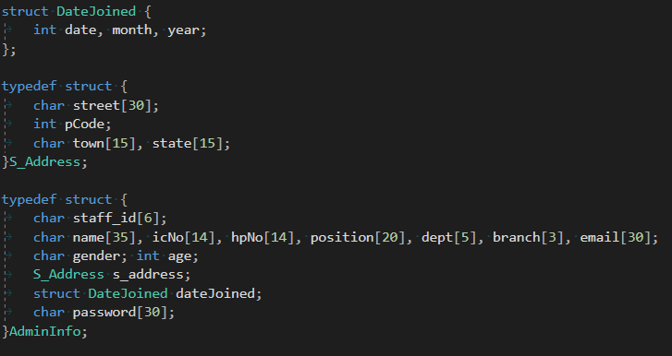
Type of Structure Used :
Tagged Struct
15%
Use tagged structure with the tag name “DateJoined” to store the data/ month and year
1
Structure name “S_Address” = Staff Address
“AdminInfo” = Admin Information
2
Typedef
To modify this graph, click on it, follow the link, change the data and replace this one here

Slide 49
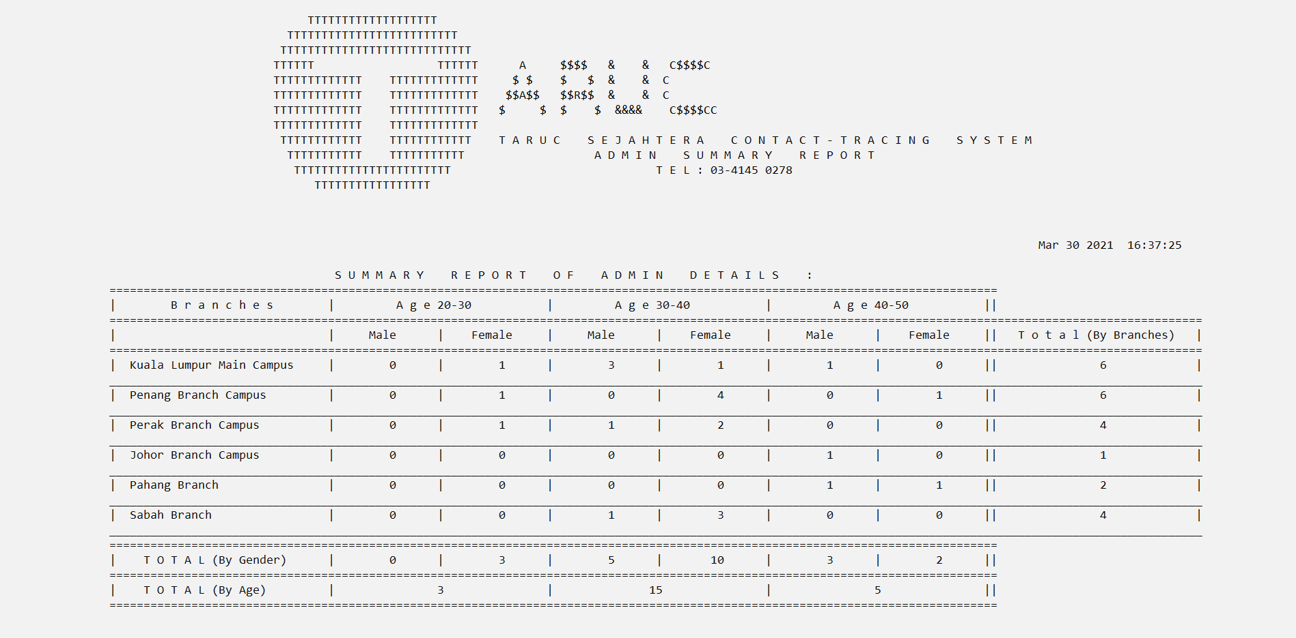
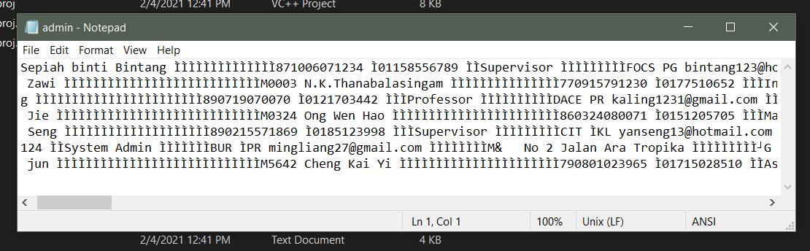
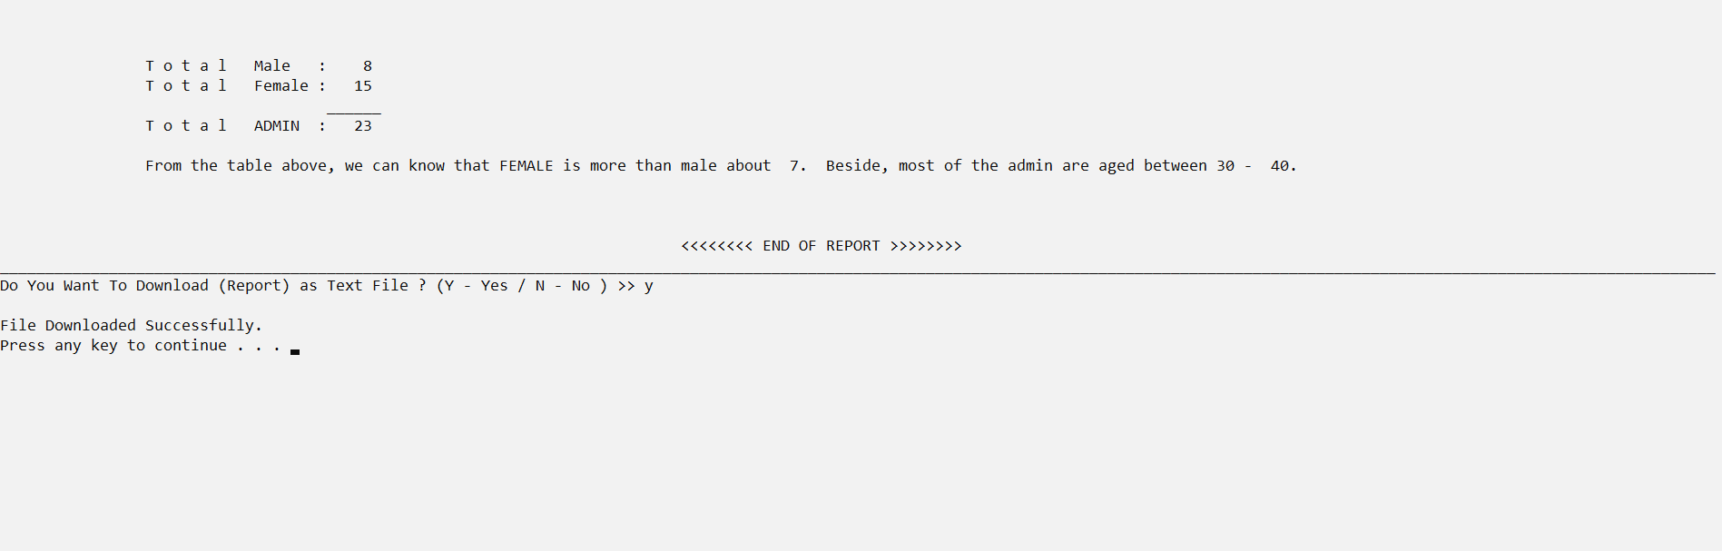
Binary File
Text File
Store Admin Info
Store report

Slide 50
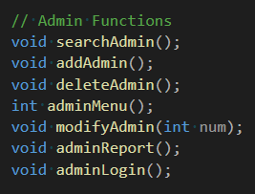
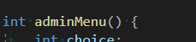
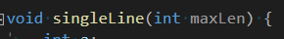
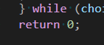
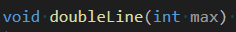
FUNCTION TYPE
Function
return
NO result
void displayHeader() {
printf("\n\n\t\t\t\t\t\t\t\tA d m i n P e r s o n a l I n f o :\n"); doubleLine(189);
printf("Staff ID Name \t\t IC No. \t\t Contact Number Position \tDepartment Branch\t\tEmail \t\t Gender\t Date Joined\t\tAddress\n");
doubleLine(189);
}
int adminMenu() {
int choice;
printf("\tH i T h e r e, p l e a s e c h o o s e :\n\n\t\t\t\t\t1.\tRegister/Add New Admin \t\t\t\t 6.\tChange Password\n\t\t\t\t\t2.\tModify/Update Admin Record \t\t\t 7.\tSummary Report\n\t\t\t\t\t3.\tDisplay All Admin Record \t\t\t 8.\tLog Out\n\t\t\t\t\t4.\tSearch Admin Record(s) \t\t\t\t 9.\tExit \n\t\t\t\t\t5.\tDelete Admin (Record) \t\t\t\t 10.\tBack \n\n");
doubleLine(189); printf("Choice >> "); scanf("%d", &choice);
rewind(stdin);
switch (choice)
{
//1 for add record
case 1:addAdmin(); break;
//2 for modify
case 2:modifyAdmin(1); break;
//3 for display
case 3:displayAllAdmin(); break;
case 4:// 4 for search
searchAdmin(); break;
case 5:deleteAdmin(); break;
case 6:modifyAdmin(2); break;
case 7:adminReport(); break;
case 8:system("pause"); adminLogin(); break;
case 9:exit(1); break;
case 10:adminLoginMenu(); break;
default:
printf("Invalid Choice Entered.\nPlease Try Again.\n"); system("pause"); system("cls");
break;
}
} while (choice < 1 || choice>10);
return 0;
}
void singleLine(int maxLen) {
int a;
for (a = 0; a < maxLen; a++)
printf("_");
printf("\n");
}
Function
return
SINGLE
result
Function with
INPUT/
OUTPUT
parameter

Slide 51
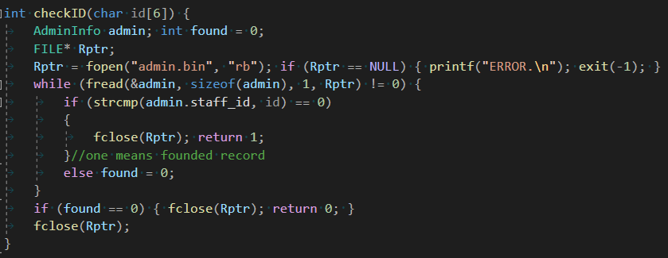
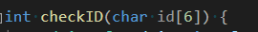
FUNCTION TYPE
Function
return
MULTIPLE
result
Passing Structure to function
Passing Array to function

Slide 52
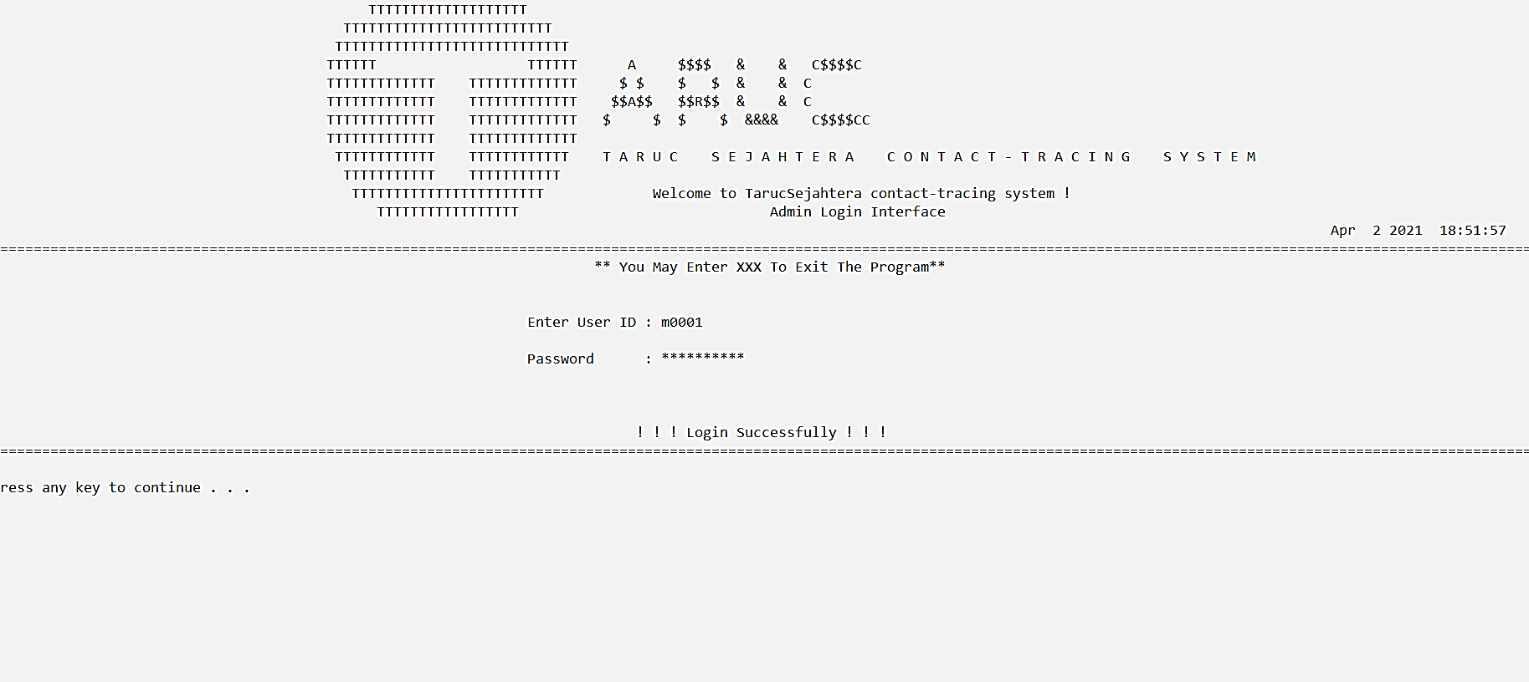
Admin Login Interface
Password is encrpyted in *

Slide 53
04
VISIT AND EXIT
BY : TAN JENNY

Slide 54
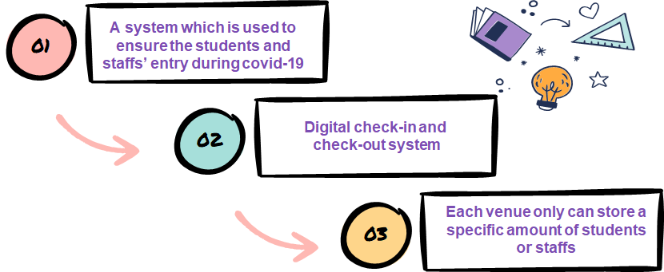
ABOUT VISIT AND EXIT MODULE

Slide 55


TYPE OF STRUCTURE
1 ) Tagged structure
2 ) Typedef structure
3 ) Structure variable

Slide 56

Tagged STRUCTURE
struct Symptoms {
int fever, cough, breath, headache, contact;
};
struct Entrance {
char entryId[10];
Checkin in;
Checkout out;
struct Symptoms symptoms;
};
Nested structure

Slide 57

2. Typedef STRUCTURE
typedef struct {
char venueId[30], id[20], purpose[60], risk[10];
int checkInHours, checkInMinutes, checkInDay, checkInMonth,
checkInYear;
double temp;
struct Symptoms symptoms; //nested structure
}Checkin;
typedef struct {
int outHour, outMins, totalMins, feedback, rating;
char feed[15], rate[15];
}Checkout;
Check In
Check Out

Slide 58
3. STRUCTURE variables
struct {
int checkInDay, checkInMonth, checkInYear,
checkInHours,checkInMins, exitHour, exitMins, duration;
double temp;
char personalId[10], entryId[10], venueId[30],
purpose[30],
rate[10], feedback[15], risk[10];
} backup;

Slide 59
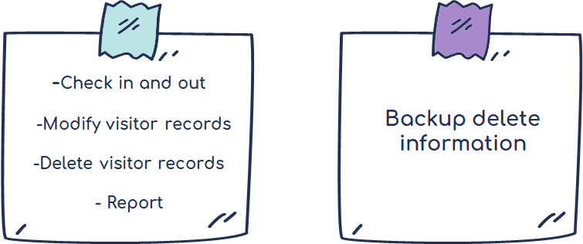
Binary File
Text File

Slide 60
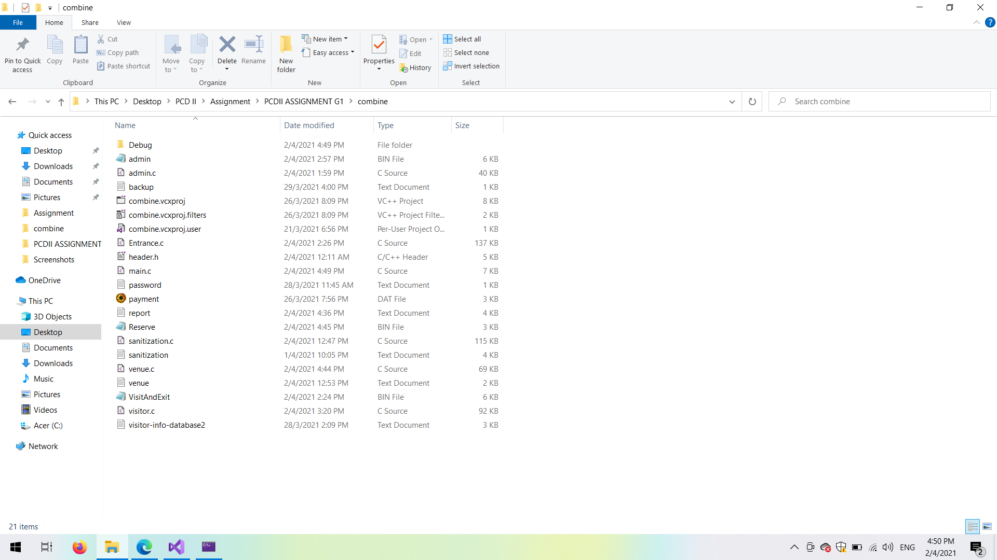


Binary File
Text File

Slide 61

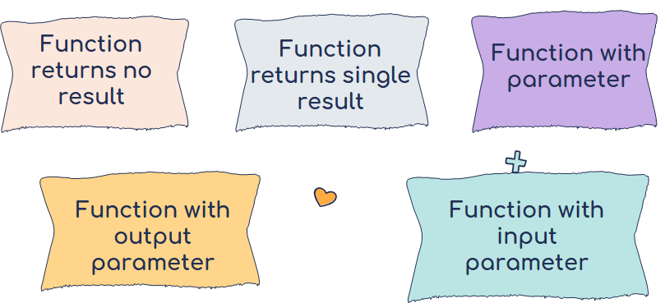

Slide 62


Function returns no result
void sound() {
Beep(610, 450);
}
Sample video

Slide 63

Function returns no result
void typeOfEntrance(char currentUserId[]) {
printf("\t\t\t\t\t\t -- Safe entry -- \n");
printf("\t\t\t\t\t\t \n");
printf("\t\t\t\t\t\t (1) - CHECK IN ('I') \n ");
printf("\t\t\t\t\t\t (2) - CHECK OUT('O') \n ");
printf("\n\t\t\t\t\t\t Please enter your entry ('I'/'O') -> ");
rewind(stdin);
scanf("%c", &type);
switch (type) {
case 'I':
case 'i':
system("cls");
checkIn(currentUserId);
break;
case 'o':
case 'O':
system("cls");
checkOut(currentUserId);
break;
default:
sound();
}
Function with input parameter

Slide 64

Function returns no result
void action() {
printf("\n --------------------------------------\n");
printf(" | What actions do you wish to ? |\n");
printf(" | >> 1. Back to MENU |\n");
printf(" | >> 2. EXIT |\n");
printf(" --------------------------------------\n");
printf("\tYour option (1/2) -> ");
}
Used in every visit & exit function when user do not want to continue the function

Slide 65

Function with input parameter
bool checkIsNum(int input) {
'0' + input;
if (input < 0 || input>127) {
return false; //not a number
}
else return true; //Is a number
}
To validate the user input is a digit

Slide 66
do {
do {
printf("\n\t\t\t\t\t\t\t\t Your option -> ");
rewind(stdin);
scanf("%d", &choice);
validate = checkIsNum(choice);
switch (choice) {
case 1:
displayHistoryAdmin(entry);
break;
case 2:
modifyEntry(entry);
break;
case 3:
searchEntry(entry);
break;
case 4:
deleteEntry(entry);
break;
case 5:
entranceReport(entry);
break;
case 6:
exit(1);
break;
case 7:
adminLoginMenu();
break;
default:
sound();
}
} while (choice != 1 && choice != 2 && choice != 3 && choice != 4 && choice != 5);
} while (validate == false);
Input parameter ( To validate the user input is a digit )
Input parameter ( To receive structure variables)
Input parameter ( To validate the user input is a digit )

Slide 67

void monthInEng(int mth) {
int x = 0;
if (mth == 1)
printf("JANUARY");}
else if (mth == 2)
printf("FEBRUARY");
else if (mth == 3)
printf("MARCH");}
else if (mth == 4)
printf("APRIL");
else if (mth == 5)
printf("MAY");
else if (mth == 6)
printf("JUNE");
else if (mth == 7)
printf("JULY");
else if (mth == 8)
printf("AUGUST");
else if (mth == 9)
printf("SEPTEMBER");
else if (mth == 10)
printf("OCTOBER");
else if (mth == 11)
printf("NOVEMBER");
else if (mth == 12)
printf("DECEMBER");
}
Pass month by parameter
if (found >= 1) {
printf("\n Monthly Report
of Number of visitors in each
Venue in : ");
monthInEng(month);
}

Slide 68

Special features
while (fread(&entry[i], sizeof(struct Entrance), 1, fp) != 0) {
//read the entry ID from the binary file
sscanf(entry[i].entryId, "X%d", &runningnum);
num++;
i = num;
}
fclose(fp);
//Continue entry on for the running number
runningnum++;
sprintf(entryId, "X%003d", runningnum);
Auto assign a running number of entry ID when check-in

Slide 69
05
SANITIZATION
BY : CHENG CAI YUAN

Slide 70


Record the reservation of sanitization
Staff will not make double reservations for a venue at a same time
Record the details of previous sanitizations
Staff can look back to know that which company has a better service rate

Slide 71


STRUCTURE
TAGGED STRUCTURE
TYPE DEFINITIONS STRUCTURE
STRUCTURE VARIABLE

Slide 72

TYPE DEFINITIONS STRUCTURE
typedef struct {
int start_hour, start_minute, end_hour, end_minute,san_day, san_month, san_year;
}DateTime;

Slide 73

TAGGED STRUCTURE
struct SanitizationDetail {
char venue[50];
DateTime datetime;
};

Slide 74

STRUCTURE VARIABLE
struct {
char com_Name[80], contact_Person[50], address[100];
char per_Number[12], com_Number[10], ID[7];
struct SanitizationDetail detail;
}s, sRecord[100];

Slide 75
NESTED STRUCTURE
typedef struct {
int start_hour, start_minute, end_hour, end_minute, san_day, san_month, san_year;
}DateTime;
struct SanitizationDetail {
char venue[50];
DateTime datetime;
};
struct {
char com_Name[80], contact_Person[50], address[100];
char per_Number[12], com_Number[10], ID[7];
struct SanitizationDetail detail;
}s, sRecord[100];

Slide 76
TEXT FILE
Record the reservation of sanitization details
FILE* fptrA;
fptrA = fopen("sanitization.txt", "a");
if (fptrA == NULL) {
printf("Error.Unable to open this sanitization.txt\n");
exit(-1);
}
fclose(fptrA);
Example of text file that apply in add function

Slide 77
BINARY FILE
Record the previous sanitization details
FILE* fptrPA;
fptrPA = fopen("payment.dat", "ab");
if (fptrPA == NULL) {
printf("Error.Unable to open this payment.dat\n");
exit(-1);
}
fclose(fptrPA);
Example of binary file that apply in add function

Slide 78
CATEGORIES OF FUNCTION
FUNCTION THAT RETURNS NO RESULT
FUNCTION THAT RETURNS A SINGLE RESULT
FUNCTION THAT RETURNS MULTIPLE RESULT
FUNCTION WITH INPUT /OUTPUT PARAMETER
PASSING STRUCTURE TO FUNCTION

Slide 79
FUNCTION THAT RETURNS NO RESULT
void add( ) {
……
}
void display( ) {
……
}
void search( ){
……
}
void modify( ) {
……
}
void deletes( ) {
……
}
void report( ) {
……
}
switch (choice) {
case 1:add(); break;
case 2:display(); break;
case 3:search(); break;
case 4:modify(); break;
case 5:deletes(); break;
case 6:report(); break;
case 8:adminLoginMenu(); break;
default: break;
}

Slide 80
FUNCTION THAT RETURNS A SINGLE RESULT
FUNCTION WITH INPUT PARAMETER
&
printf("\tCompany contact person :");
rewind(stdin);
scanf("%[^\n]", &s.contact_Person);
strupr(s.contact_Person);
check = characterCheck(s.contact_Person);
while (check == 1) {
printf("\tInvalid company contact person!!\n");
printf("\tPlease reenter the company contact person :");
rewind(stdin);
scanf("%[^\n]", &s.contact_Person);
strupr(s.contact_Person);
check = characterCheck(s.contact_Person);
}
int characterCheck(char name[]) {
int check = 0;
for (int x = 0; x < strlen(name); x++) {
if (name[x] != ' ') {
if (isalpha(name[x]) == 0) {
check = 1;
break;
}
else
check = 0;
}
}
return check;
}

Slide 81
FUNCTION THAT RETURNS MULTIPLE RESULT
void startTimeCheck(char time[100], int* hour, int* minute) {
int hr, min;
printf("%s", time);
rewind(stdin);
scanf("%d:%d", &hr, &min);
while (hr < 0 || hr > 23 || min < 0 || min > 59) {
printf("\tInvalid time!!\n");
printf("\tPlease reenter the sanitization starting time(in 24 hour) :");
rewind(stdin);
scanf("%d:%d", &hr, &min);
}
*hour = hr;
*minute = min;
}
startTimeCheck("\tSanitization starting time(in 24 hour) :", &s.detail.datetime.start_hour, &s.detail.datetime.start_minute);

Slide 82
PASSING STRUCTURE TO FUNCTION
while (fread(&p, sizeof(p), 1, fptrPR) != NULL) {
paymentDetail(&p, a++);
}
void serviceStruct(Service* service) {
}
void paymentDetail(struct PaymentDetail* p, int a) {
serviceStruct(&(p->service));
if (a == 0) {
printf("\n\n");
printf("\t\t\t\t\t\t\t\t\t\tLIST OF PREVIOUS SANITIZATION RECORDS\n\n");
line4();
printf(" \t\t| Payment ID | Sanitization ID | Payment Method | Payment Merchant | Payment Amount | Service Tax | Sanitization Brand | Service Rating |\n");
line5();
}
printf(" \t\t| %-10s | %-15s | %-26s | %-26s | %-14.2lf | %-12.2lf| %-25s| %-15d|\n", p->pay_ID, p->san_ID, p->pay_method, p->pay_merchant, p->pay_amount, p->service.service_tax, p->sanitizer_brand, p->service.service_rate);
}

Slide 83

BASIC FUNCTION
EXTRA FUNCTION
ADD FUNCTION
DELETE FUNCTION
DISPLAY FUNCTION
REPORT FUNCTION
SEARCH FUNCTION
MODIFY FUNCTION

